Slide 1

Implementation scenario prediction - Random forest

Slide 2
AS IS bILL of material process in xl-axiata ACCOUNT
Data Acquisition
Implementation Scenario / Detail Scope of Work
(Detail SoW)
Bill Of Material
(BoM)
Generate Inventory Data (RBS, Radio, Baseband, Qty of Cell, Layer, Port Utilization) from Ericsson Network Manager/MoShell
Get Passive Installed Equipment (Antenna,etc) Information from Engineering Team
Cross and Slice with On Going Program (SoW, HW will be installed, Implementation Status)
Get High Level SoW from Planning Team (Add LTE900, Add LTE2100, Add GSM1800/G900, MultiSector, and MIMO (1800/2100)
Processing High Level SoW to Implementation Scenario / Detail Scope of Work based on Inventory Data, On Going Program, and Passive Installed Equipment, and Guideline
Generate BoM based on Implementation Scenario / Detail SoW, ex :
Multisector 3 sec 4T6S with Swap to 4xRadio4499B1B3 will generate BoM : 4pcs Radio4499, 4 Optic Cable, 4pcs DC Cable, License, Antenna,etc
To Vertical and Summarize Material & Service for Pricing Review by Account Team

Slide 3
Basic Theory (Decision Tree & Random Forest) - 1
A decision tree is a decision support tool that uses a tree-like model of decisions and their possible consequences, including chance event outcomes, resource costs, and utility. Source : https://en.wikipedia.org/wiki/Decision_tree
Decision Tree & Random Forest are part of algorithm of Machine Learning. In this case, these are used for supervised learning.
Golfer
Overcast
Rainy
Sunny
If Windy = FALSE
No, I Don’t Play Golf
If Windy = TRUE
Yes, I Play Golf
Yes, I Play Golf
If Humidity = High
No, I Don’t Play Golf
If Humidity = Normal
YES, I Play Golf
Need To Build Another Decision Tree

Slide 4

Basic Theory (Decision Tree & Random Forest) - 2
Random forests or random decision forests is an ensemble learning method for classification, regression and other tasks that operates by constructing a multitude of decision trees at training time. For classification tasks, the output of the random forest is the class selected by most trees
There are several parameters that shows effectiveness of ML Model : features, enthropy, information gain, and etc
Definition :
Features : Variable that impact result
Enthropy : Randomness of the Data
Information Gain : Feature Probability that provides maximal information about classification
Golfer
Overcast
Rainy
Sunny
If Windy = FALSE
No, I Don’t Play Golf
If Windy = TRUE
Yes, I Play Golf
Yes, I Play Golf
If Humidity = High
No, I Don’t Play Golf
If Humidity = Normal
YES, I Play Golf
Golfer
Overcast
Rainy
Sunny
If Windy = FALSE
No, I Don’t Play Golf
If Windy = TRUE
Yes, I Play Golf
Yes, I Play Golf
If Humidity = High
No, I Don’t Play Golf
If Humidity = Normal
YES, I Play Golf
Golfer
Overcast
Rainy
Sunny
If Windy = FALSE
No, I Don’t Play Golf
If Windy = TRUE
Yes, I Golf
If Humidity = High
No, I Don’t Play Golf
If Humidity = Normal
YES, I Play Golf
If Temperature = Very Hot
No, I don’t Play Golf
YES, I Play Golf
YES, I Play Golf
No, I Don’t Play Golf
Major Vote (2/3 Vote) = YES, I Play Golf

Slide 5
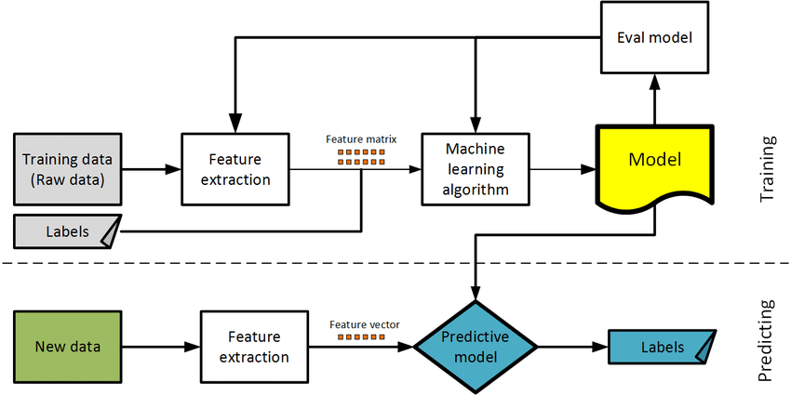
Flow Diagram – How to Build supervised Machine Learning
Data Cleaning
Data Generation
Data Cleaning
Scope of Work of Data Cleaning :
- Preformat Data
- Handle Missing Data
- Verify Data Validity and Right Data

Slide 6
CURRENT SITUATION & PAIN Point - 1
Data for Training Set Has Not Scrutinize for Solution Accuracy.
Data for Training/Predictive Set Has Not been Preformat.
And, Others…..in the next Pages

Slide 7
CURRENT SITUATION & PAIN Point - 2
Some Model Accuracy is still below average.
For Radio Prediction Model, it requires more training set and scrutinize check for detail Radio SoW.
For Baseband Prediction Model, it requires baseband port utilization training set, and scrutinize check for detail Baseband SoW
For Antenna Prediction Model, it requires Model hyperparameter tuning.

Slide 8
